Slide 2
Water Resource
Surface Water resource
Ground water resource

Slide 3
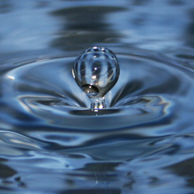
Surface Water Resource
Water Res
70% of India’s useable water is surface water resource
Rivers, lakes and ponds
Rivers are most important for water resource
India’s important rivers: Himalayan rivers and peninsular river

Slide 4
Comparison
Himalayan rivers
Peninsular rivers
Perennial
antecedent
Larger , wide flood plain, huge sediments, low slope gradient, meandering
flood-prone
Seasonal
superimposed
Smaller, not broad catchment – hard-rocks below – no shifting of course
less flood-prone

Slide 5
Comparison
Himalayan rivers
Peninsular rivers
Water fall at only youthful stage (mountainous areas)
Navigable (Allahabad to Hugli and Sadia to Dhubri)
Easily diverted for irrigation
Hard rocks – water fall at any course of river
Not navigable
Need pumping for irrigation – river basing located on higher plateau
Ex. (Telangana plateau)

Slide 6
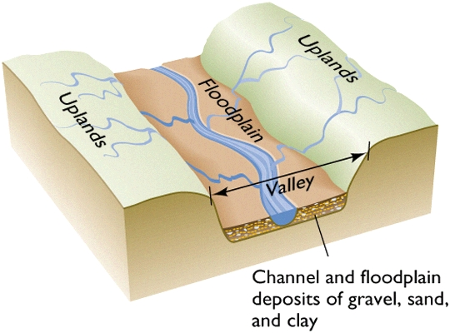
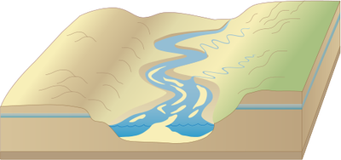
comparison
Himalayan river basin
Peninsular river basin

Slide 7
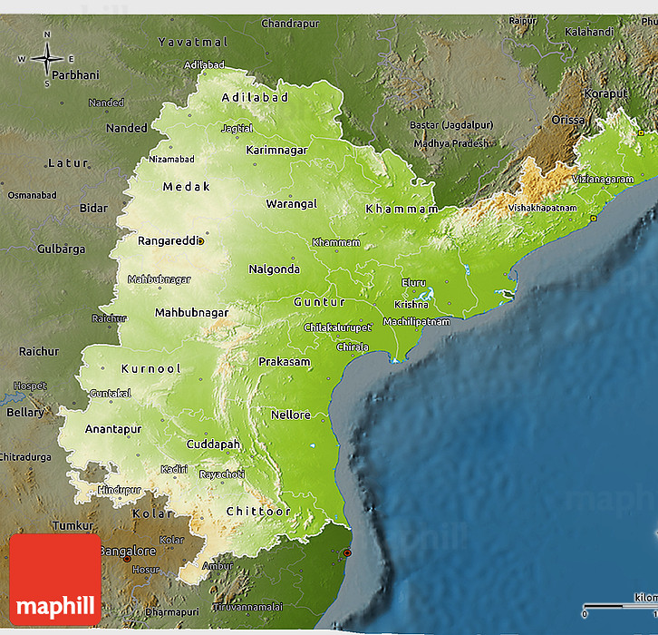
Telangana plateau
Godavari river
Telangana plateau
Krishna river
Penneru river

Slide 8
Water Resource
Surface Water resource
Ground water resource

Slide 9
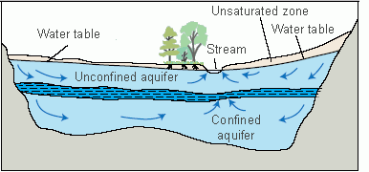
Ground water resource
Water present in pore spaces of permeable rock– below the surface = GW
Rainwater/ river water percolate the soil – through pores and cracks reach till aquifer
Aquifer = storage pool of GW

Slide 10
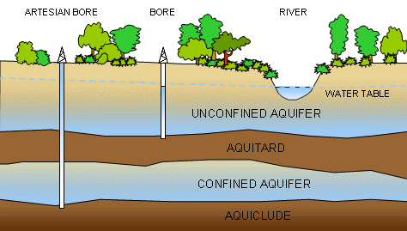
Ground water resource
Sand or permeable rocks like sandstone = good aquifers
when all the pores are filled = saturated zone
Upper layer of saturated zone = water-table

Slide 11
Ground water resource in India
Ground water reserves: 30-40 ml ha in India
Not found everywhere
4 most prominent regions

Slide 12
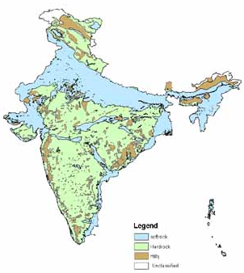
Ground water resource: Location
Alluvial sedimentary - Northern plains
- Peninsular river basins
Deltas of rivers
High water table

Slide 13
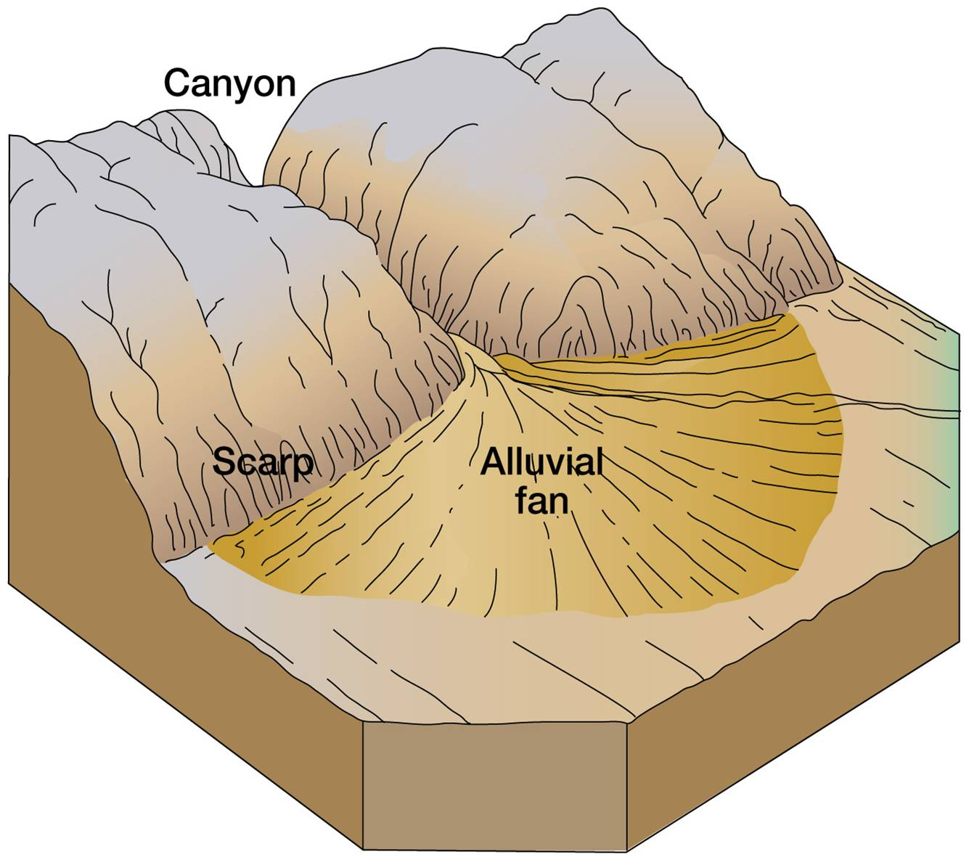
Ground water resource : Location
2) Bhabhar (foothills of Himalayas)
Not important
Coarse topography – no soil
Not important for agriculture

Slide 14
Ground water resource : Location
3) East and west coastal plains
Eastern coastal plain broader and receive large amount of rivers
Issue of over-use
Vulnerable to salinity

Slide 15
Ground water resource : Location
4) Peninsular gneissic and granitic rocks- Impermeable rocks – water stored in cracks
-once water is extracted difficult to recharge – easily exhausted
Telangana, Dharwad, Bastar, Rayalseema

Slide 16
Ground water reserve in India
Ground water Reserve | Total ground water reserve
Ganga | ~17 ml ha
Godavari | ~5 ml ha
Brahmaputra | ~2.8 ml ha
Krishna | ~2.6 ml ha
Indus | ~2.5 ml ha

Slide 17
Development of use of GW
Ground water Reserve | Level of GW development
Indus (+PN-HN) | ~80%
Cauveri | ~45%
Kutchh-Saurashtra | ~40%
Ganga basin | ~31%
Penner basin | ~30%

Slide 18
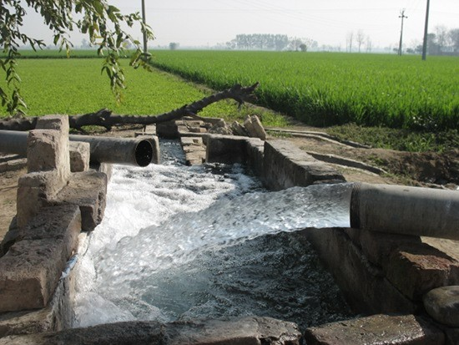
Ground water usage
50% already used
rural household = >90%
urban household = ~60%
Un-planned urban expansion – unreliable municipal water supply – urban sprawl
GW cheap source, need no infra

Slide 19
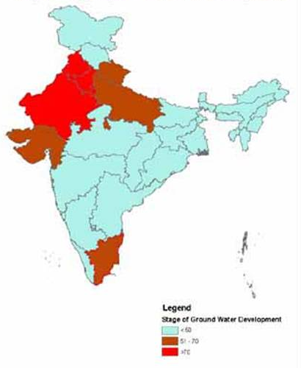
Ground water usage
Tube well revolution
Now 60% of India’s irrigation through dug-wells and tube-wells
Highest in PN-HN, RJ, UP, GJ and TN
Water-table going down
Aquifers are drying up

Slide 20
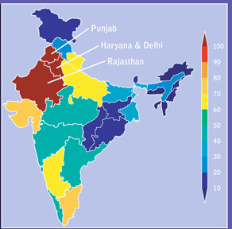
Present availability of GW
Rate of usage > rate of replishment
cities: alarming rate of fall of GW table
Destruction of aquifers
Over-dependent on GW- salinity

Slide 21
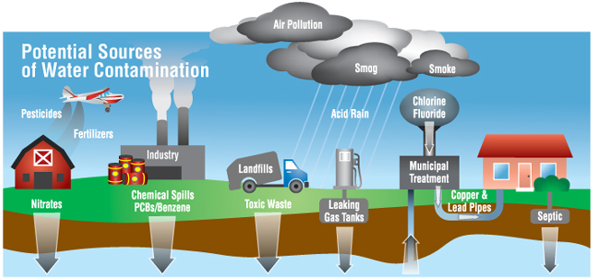
Ground water pollution
Fluoride- northern plains, Telangana, Golkonda
Arsenic – leather industries- UP, Bihar, WB (Malda, murshidabad, Burdwan, Asansol)
Nitrate – fertilizers- across country

Slide 22
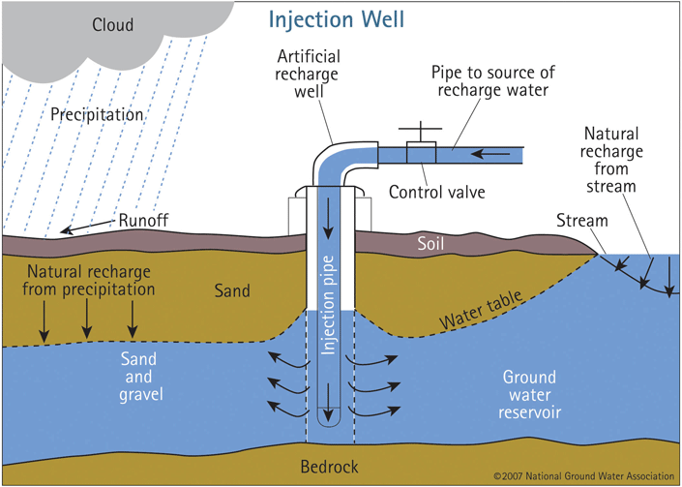
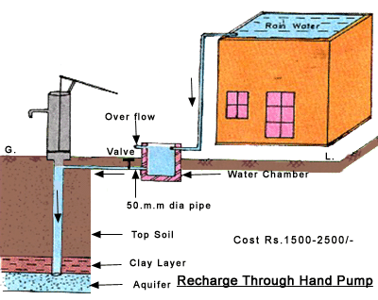
Artificial Recharge
Rainwater Harvesting+ recharge

Slide 23
Issues related to water
Current water availability 2000 cum/person/year
By 2050, water demand would be 3500 cum/person/year
But actual availability will be 1200/cum/person/year
Potential water crisis in the future

Slide 24
Climatic regions of India
Vegetation pattern in India
Water resource:
Surface water resource
Ground water resource

